Slide 1

Bank Loan Term Prediction
Ali Ahmed Abdulrahman

Slide 2
Table of contents
01
Introduction
02
Data Analysis
03
Data Cleaning and Feature Engineering
04
Classification Models
05
Conclusion

Slide 3
01
Introduction

Slide 4

Backstory
Loan is one of the most important schemes of banks.
Short Term Loan or Long Term Loan.
Buying a house → Long term.
Take a trip → short term.
Help bankers to determine the type of loan.

Slide 5
Data set
Tools
Bank Loan Status Dataset
Kaggle.
110867 rows.
19 column.
16 feature columns.
1 binary class target column
Target column:
Short term
Long term
Pandas
Numpy
Matplotlib
Seaborn
Sklearn
XGBoost
Pickle

Slide 6
02
Data Analysis

Slide 7
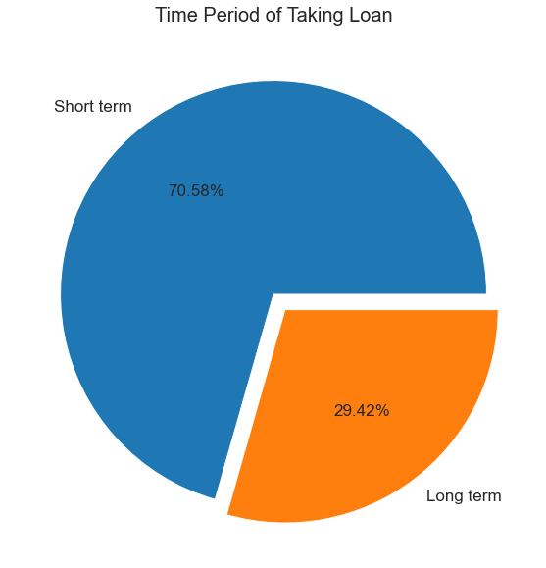
Type of Terms Plot

Slide 8
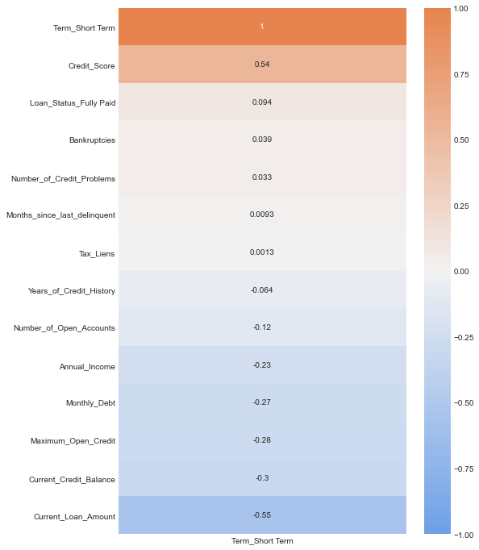
Features and Target Correlation

Slide 9
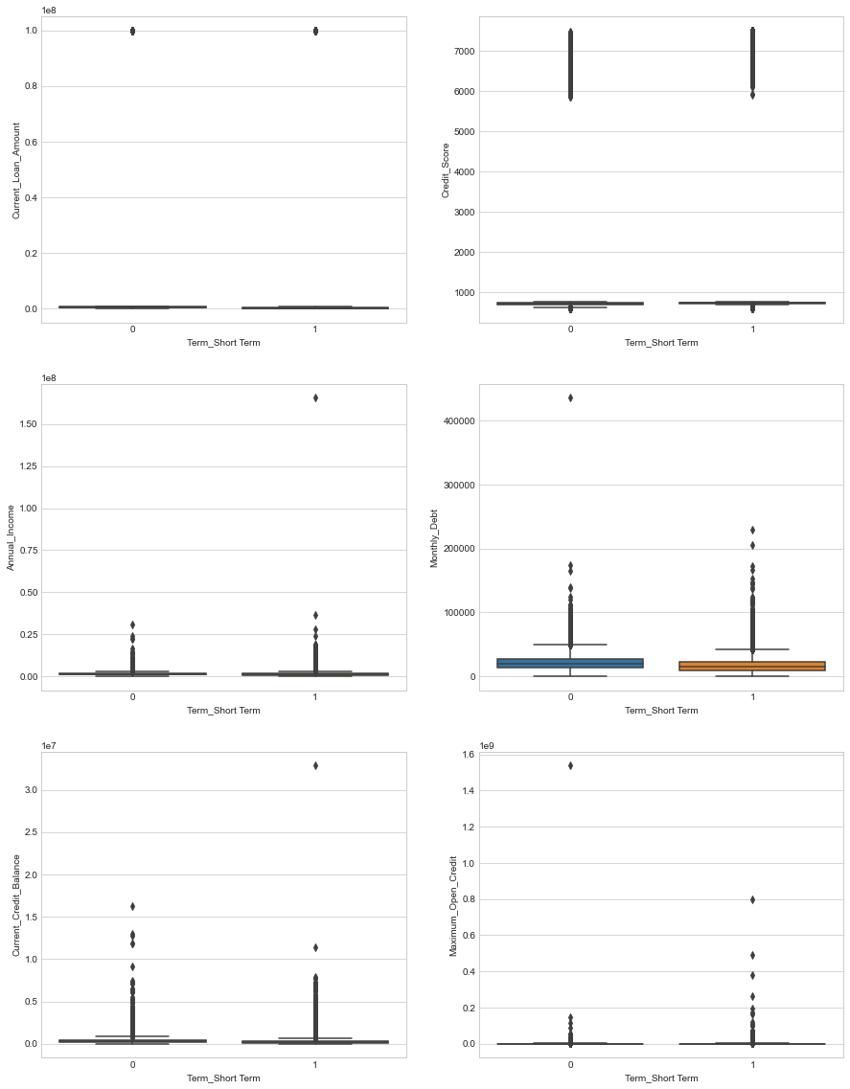
Outliers Boxplot
Current Loan Amount for short and long term loan
Monthly Dept for short and long term loan

Slide 10
03
Data Cleaning and Feature Engineering

Slide 11
Data Cleaning
01
Check for NaN and deal with them.
02
Drop unwanted columns.
Loan ID , customer ID
03
Check and drop duplicate.
04
Check and drop outliers.

Slide 12
Feature Engineering
New columns
$${(Credit Score)}^{3}$$
$$(Current Loan Amount) ∗(Credit Score)$$
$${(Annual Income)}^{0.05} ∗(Current Loan Amount)$$
$${\left(\sqrt{Current Credit Balance}∗\left(Credit Score\right)\right)}^{2}$$

Slide 13
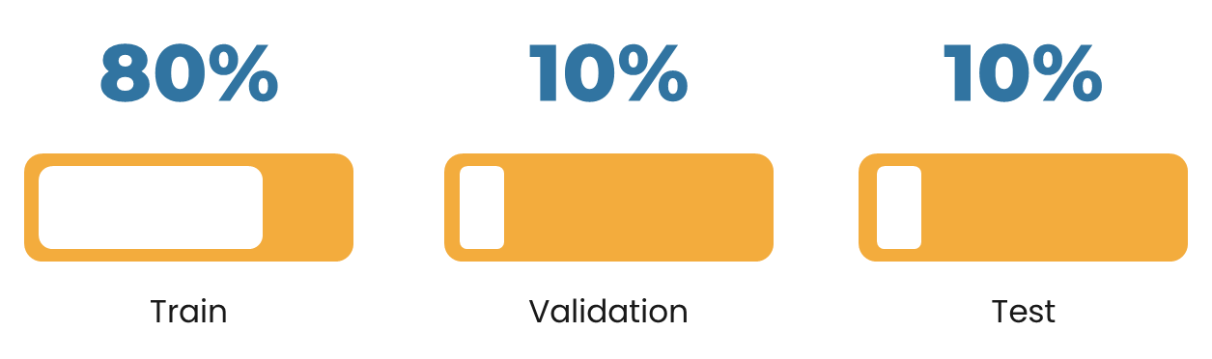
04
Classification Models

Slide 14
Baseline Model
Logestic Regression
Before FE
After FE
0.8020
0.8423
Train accuracy
0.7897
0.8327
Validation accuracy

Slide 15
Logistic Regression
Model | Accuracy
 | Train | Validation
Logistic Regression | 0.8423 | 0.8327
Logistic Regression Scaled | 0.8613 | 0.8670
LogisticRegression class weight {Long Term : 2 , Short term : 1} | 0.8435 | 0.8466
LogisticRegression class weight : balanced | 0.8382 | 0.8363

Slide 16
Naive Bayes
Model | Accuracy
 | Train | Validation
Gaussian NB | 0.8311 | 0.8308
Bernoulli NB | 0.6871 | 0.6888
Multinomial NB | 0.7807 | 0.7771
Logistic Regression Scaled | 0.8613 | 0.8670

Slide 17
Contents of this template
Model | Accuracy |  | F1 Score
 | Train | Validation | Train | Validation
Logistic Regression Scaled | 0.8613 | 0.8670 | 0.9045 | 0.9044
K-Neatest Neighbors (3) | 0.9051 | 0.8332 | 0.9339 | 0.8849
Decision Tree | 0.8741 | 0.8683 | 0.9148 | 0.9073
Random Forest | 0.9999 | 0.8732 | 1.0 | 0.9141
Extra Tree | 1.0 | 0.8699 | 1.0 | 0.9111
Ada Boost | 0.8738 | 0.8758 | 0.9131 | 0.9155
Stochastic Gradient Descent | 0.8580 | 0.8616 | 0.9035 | 0.9067
XGBoost | 0.8916 | 0.8856 | 0.9266 | 0.9179

Slide 18
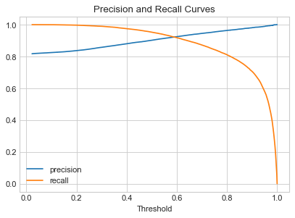
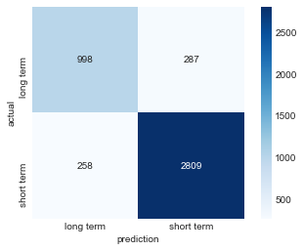
Best Classification model
XGBoost classifier
Precision: 0.9225
Recall: 0.9220

Slide 19
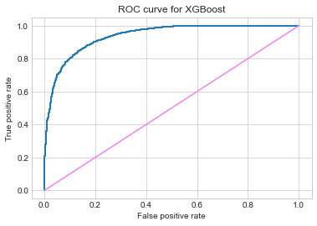
ROC AUC Curve
XGBoost classifier

Slide 20
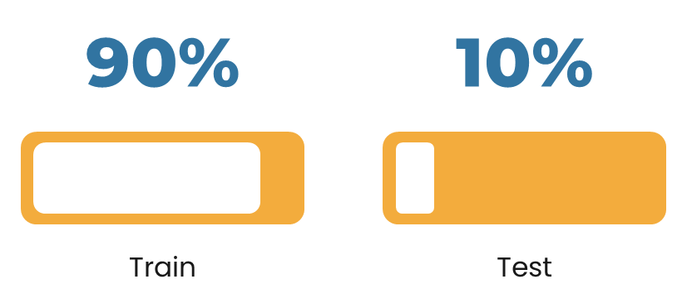
05
Conclusion
Accuracy
Train: 0.8859
Test: 0.8812
XGBoost
F1 Score
Train: 0.9215
Test: 0.9181

